Slide 1
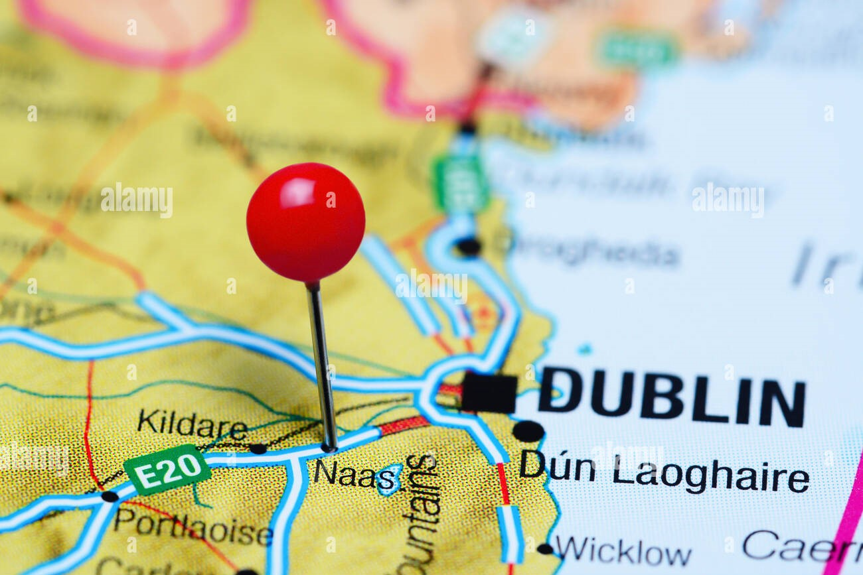

Transportation in
Naas, Co. Kildare, Ireland
Presented by,
Teja Rose Jijo
22250289

Slide 2
Introduction
Why I choose this topic?
Naas is a small town in Co. Kildare.
It is a beautiful town with so much places to visit. So a clear visualization of road services may help others to explore Naas more.
I’ve been living here for past 3 months and I would like to explore transportation systems as an international student as well as get others know what all transportation faculties and route maps are available in Naas
Through this project, I would like to show the possibilities to international students especially who comes to Maynooth University can choose Naas as places to stay, as I do now, because of the housing crisis and high rent existing in Maynooth and let them know that bus services are available to most of the cities from Naas especially to Maynooth.

Slide 3
Collection of Spatial Data for Visual Analysis
These geospatial data were mainly collected in the form of shape files or GeoJSON files from geofabric, OpenStreetMap.​
Thereafter, spatial data of bus and dart routes were extracted from the above files.​
The resulting information's thus obtained are primarily used for the analysis below.​

Slide 4
Transportation Systems in Naas
Most of the dart and Bus services are not starting or ending in Naas and they pass through Naas starting from Dublin and ending in Newbridge
Main transportation services used in Naas are :
  Dart Services (Iarnród Éireann / Irishrail) .
  Bus Services are:
Bus Name | Bus Numbers
J.J. Kavanagh & Sons | 139
Go-Ahead Ireland | 120, 125, 126, 130
Dublin Coach | 600, 736

Slide 5
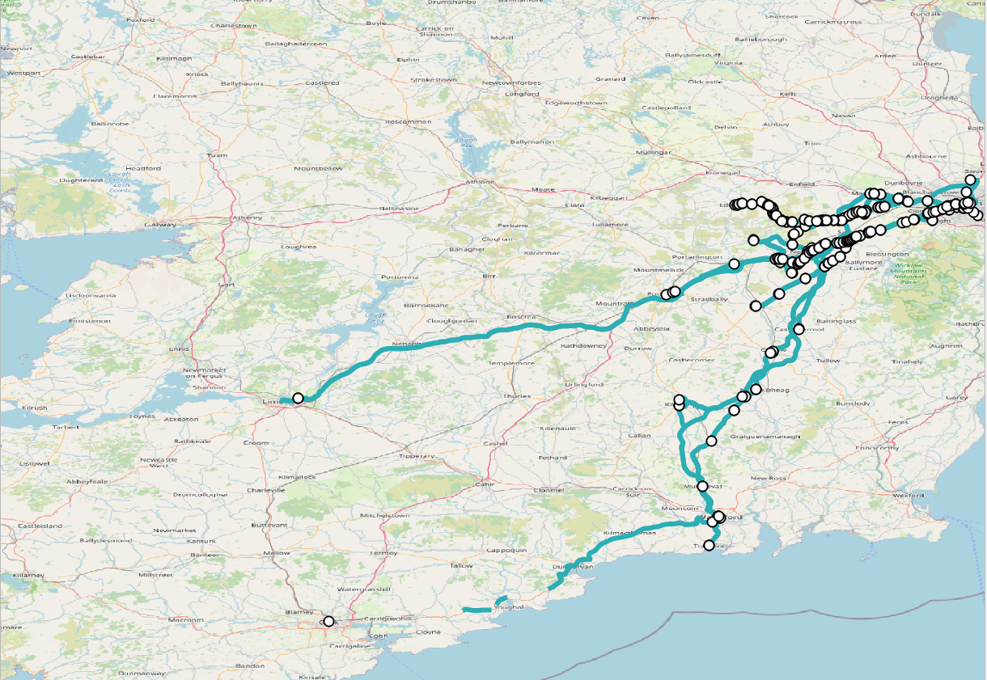
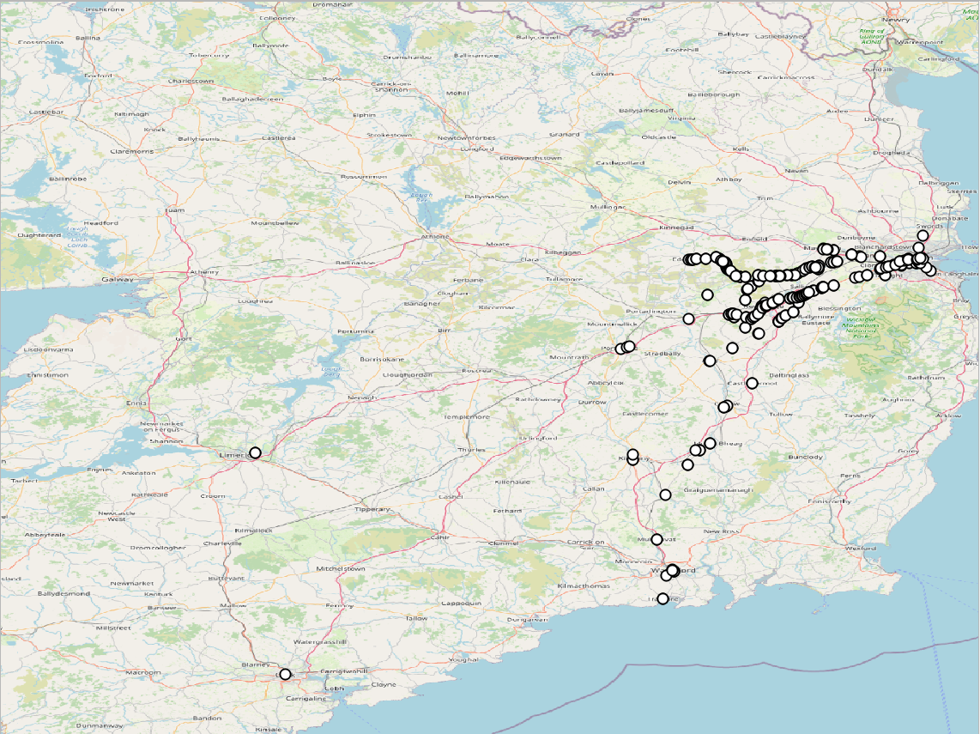
Bus Services
Overall Bus service routes through Naas and bus stop distribution

Slide 6
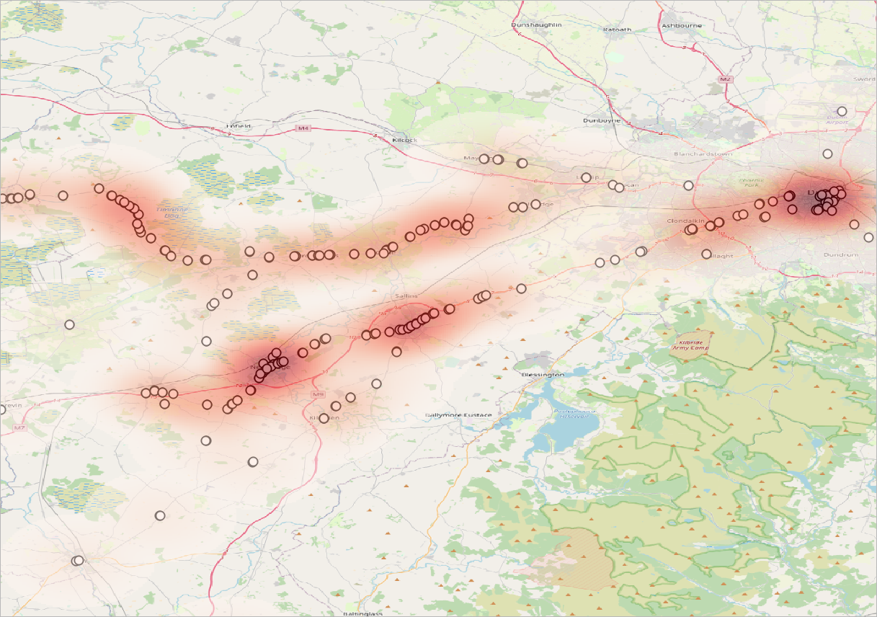
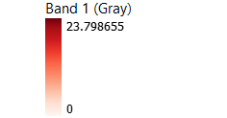
Heat map on bus stops

Slide 7
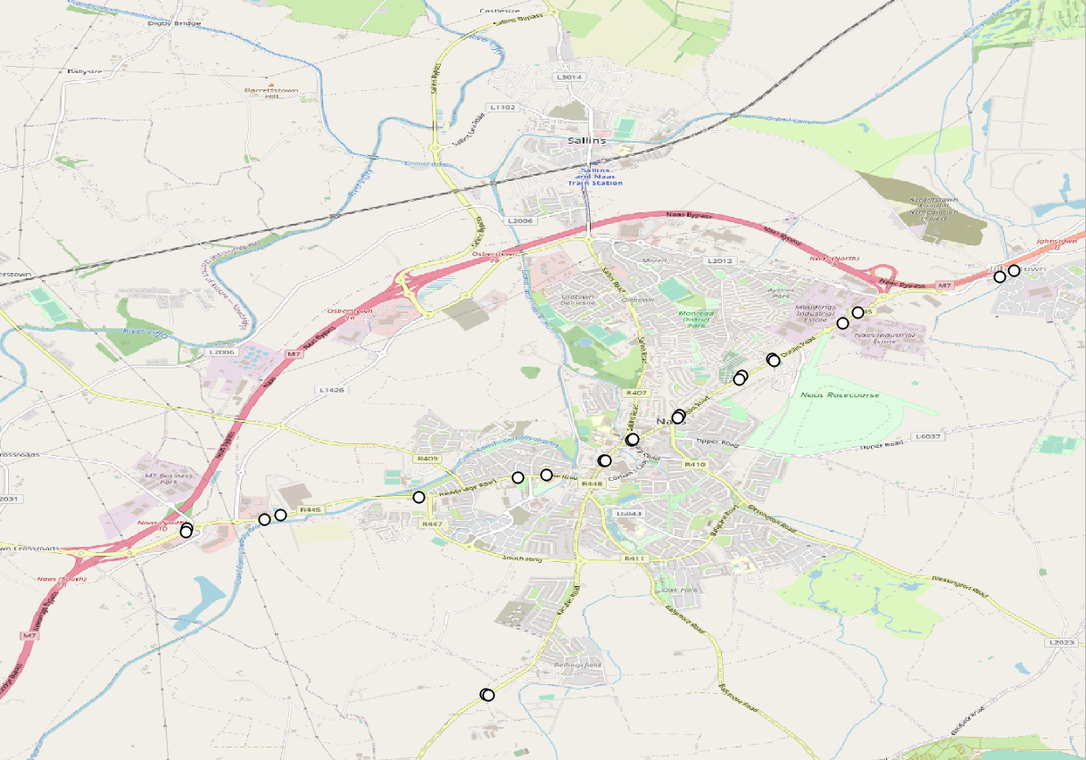
Bus stop distributions in Naas
From the map, we can see that there are overall 17 bus stops in Naas, which them split to different directions.
Dublin and Newbridge are the main destinations of the bus services through Naas and others include Tramore, Kildare, Rathangan, Blanchardstown I.T., Cork and Edenderry

Slide 8
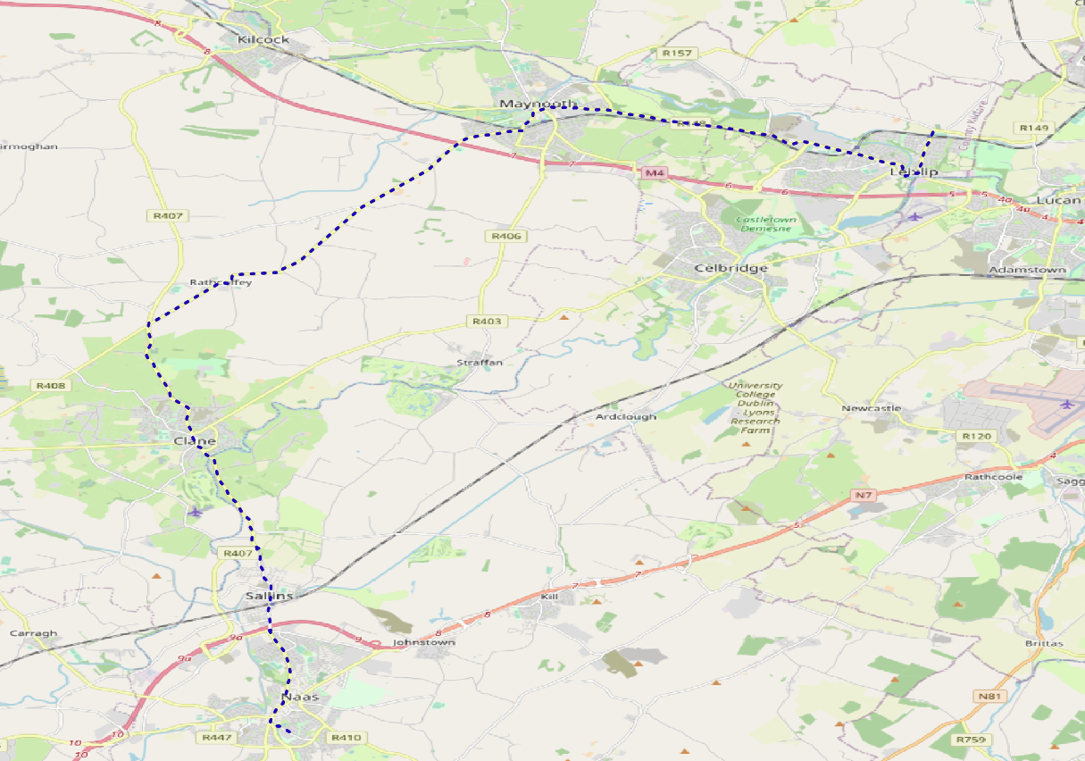
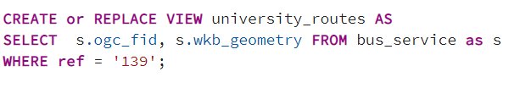
Maynooth to Naas and vice versa
Map here shows the way from Maynooth to Naas
Bus number 139 does the service .
Bus service starts at Blanchardstown I.T and ends in Naas, specifically Naas hospital and vice versa.
Query used is shown as below

Slide 9
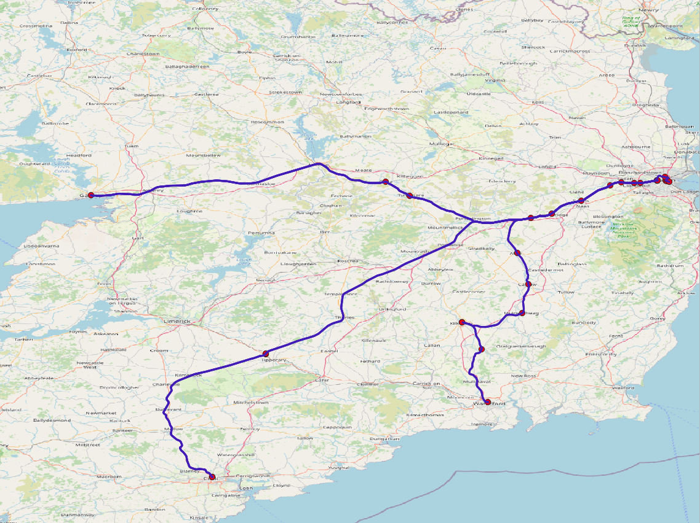
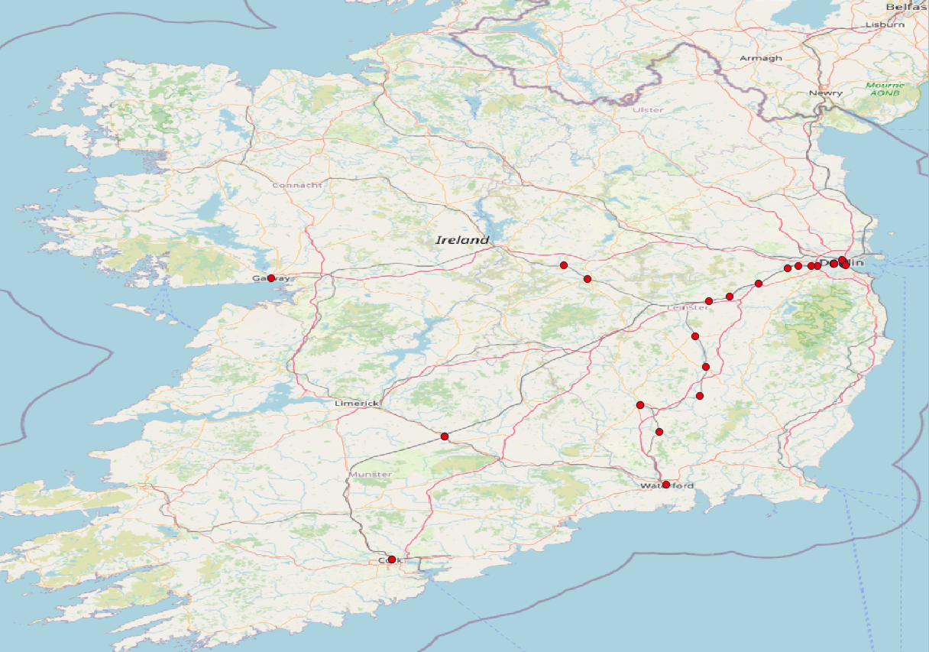
Dart Services
Overall Bus routes through Naas and bus stop distribution

Slide 10
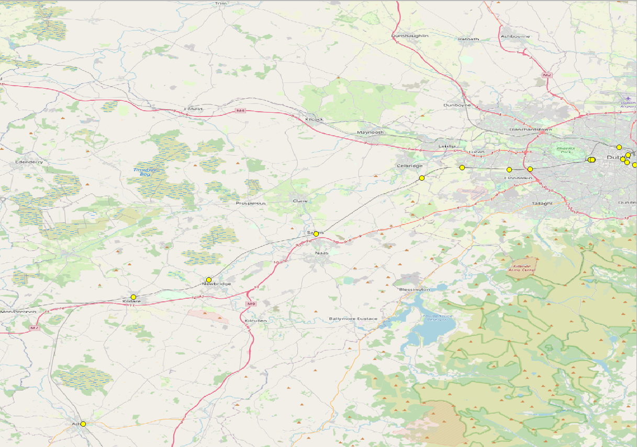
Distribution of dart stops in Naas

Slide 11
Conclusion
Transportation in Naas is basically 2 services Bus and Dart.
As the maps shows, bus is better way to reach Naas than Dart is as it reaches Salins which is near by place and has to consider another mode of transport to Naas.
Naas has total of 17 bus stops spread across the town from where bus can be taken to main cities like Dublin , Newbridge, Edenderry, Cork and mainly Dublin Airport.
The main bus services are J.J. Kavanagh & Sons, Go-Ahead Ireland, Dublin Coach.
Nearest university is Maynooth University and bus service to here is J.J. Kavanagh & Sons (139).

Slide 12
Thank You Peter Mooney

